Slide 1
SETTING
Developing your setting through senses and more

Slide 2
Why is Setting important?
Without a setting, how are your readers going to know what is going on with your characters if they don’t know where they are located?
The setting of a story is the location and time frame of where a story takes place
Without the setting, we do not know where the majority of action takes place and where the characters live out the plot.
It is the author’s job to state where the characters are located in the story and when
We help the reader visualise what the setting is like through the use of senses

Slide 3
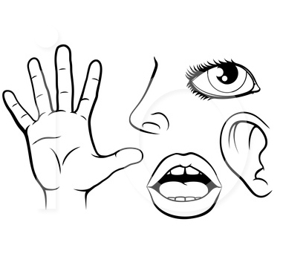
Senses
There are five senses: sight, smell, taste, sound, and feel.
Without these senses, you will have a hard time conveying how the sand feels between your toes or how the wind sounds when it howls through the trees in a storm.
As the author, you have to have the ability to describe these senses in your work.
You want your readers to feel like the story is actually taking place and that they are experiencing the scene you lay out for them.

Slide 4
Using the Senses
Sight: I can see the sun shining and casting shadows. I can see the washing line, carrying clean clothes that are blowing softly in the breeze.
Smell: I can smell the aroma of charcoal burning on my neighbours BBQ. I can smell the sweet suncream on my skin.
Feel: I feel the summer breeze as it flows through the trees. I can feel the sun’s warmth radiating against my skin. I can feel the icy cold frozen drips of ice lolly that is melting in my hand.
Taste: I can taste the strawberry flavour of the ice lolly I am eating.
Hear: I can hear a dog barking in the distance, echoing around the houses. I can hear the birds tweeting.

Slide 5
Using the Senses
I am sitting in the garden in the height of summertime, basking in the rare Scottish heat. I look up to the bright blue sky, to see the sun shining golden rays of light, casting shadows upon the grass. A rainbow assortment of clean clothes blows softly in the breeze as it hangs on the washing line in front of me. That same summer breeze flows gently through my hair, cooling me down from the radiating warmth of the sun on my shoulders. I’m reminded of the importance of wearing suncream, and lather some on my arms, catching the scent of pineapple that brings back memories of being at the beach on holiday. My neighbours are chatting away, reminiscing about life before lockdown as they turn coals on the BBQ that burns softly in preparation for the burgers it will soon cook. My tummy rumbles with hunger, so I open the strawberry flavoured ice lolly that in no time starts to melt in my hand, icy cold drops dripping everywhere! There’s the sound of birds tweeting above me, as they sit on the rooftops singing a sweet melody in unison. I could get used to this!

Slide 6
Activity Time!
1. I want you to look around you, where you’re sitting and make a list of the five senses. Note down what you can see, hear, smell, taste and touch.
2. Now use these as a prompt to start a story. As you bring these into your writing, perhaps you will have some inspiration about the plot and start to see how it could take shape.

Slide 7
Ways to Develop Setting
Use the setting to tell the reader about your character or the conflict that may take place in your story
Research the place you are writing about
Use your setting to create atmosphere e.g. through the weather
Use specific details where you can

Slide 8
Activity Time!
Pick your favourite place in the world and start to write about it.
Remember to talk about what you can see, hear, smell, taste, touch. Use specific details and research the place you are writing about.
Let your imagination run wild!

